Slide 1
STOCK MARKET WEBSITE

Slide 2
STUDENTS INVOLVED:-
ABHISHEK SHARMA (201500023)
ADARSH PANDEY (201500028)
ANSHUL CHAUDHARY (20150115)
YOGESH TRIPATHI (201500834)

Slide 3
TECHNOLOGIES USED:-
HTML:-
HTML stands for Hypertext Markup Language. It is used to design web pages using a markup language. HTML is the combination of Hypertext and Markup language. Hypertext defines the link between web pages. A markup language is used to define the text document within the tag which defines the structure of web pages. This language is used to annotate (make notes for the computer) text so that a machine can understand it and manipulate text accordingly. Most markup languages (e.g., HTML) are human-readable. The language uses tags to define what manipulation has to be done on the text. HTML is a markup language used by the browser to manipulate text, images, and other content, in order to display it in the required format. HTML was created by Tim Berners-Lee in 1991. The first-ever version of HTML was HTML 1.0, but the first standard version was HTML 2.0, published in 1995.

Slide 4
CASCADING STYLE SHEETS (CSS):-
Cascading Style Sheets, fondly referred to as CSS, is a simply designed language intended to simplify the process of making web pages presentable. CSS allows you to apply styles to web pages. More importantly, CSS enables you to do this independent of the HTML that makes up each web page. It describes how a webpage should look: it prescribes colours, fonts, spacing, and much more. In short, you can make your website look however you want. CSS lets developers and designers define how it behaves, including how elements are positioned in the browser.
While html uses tags, CSS uses rulesets. CSS is easy to learn and understand, but it provides powerful control over the presentation of an HTML document.
Inheritance, the Cascade, and Specificity are the big three. Understanding these concepts will allow you to write very powerful stylesheets and save time by writing fewer CSS rules.
Every element in CSS can be represented using the BOX model
It allows us to add a border and define space between the content
It helps the developer to develop and manipulate the elements

Slide 5
JAVASCRIPT:-
JavaScript is a dynamic computer programming language. It is lightweight and most used as a part of web pages, whose implementations allow client-side script to interact with the user and make dynamic pages. It is an interpreted programming language with object-oriented capabilities.
JavaScript was first known as Live Script, but Netscape changed its name to JavaScript, possibly because of the excitement being generated by Java. JavaScript made its first appearance in Netscape 2.0 in 1995 with the name Live Script. The general-purpose core of the language has been embedded in Netscape, Internet Explorer, and other web browsers.
The ECMA-262 Specification defined a standard version of the core JavaScript language.
JavaScript is a lightweight, interpreted programming language.
Designed for creating network-centric applications.
Complementary to and integrated with Java.
Complementary to and integrated with HTML.
Open and cross-platform

Slide 6
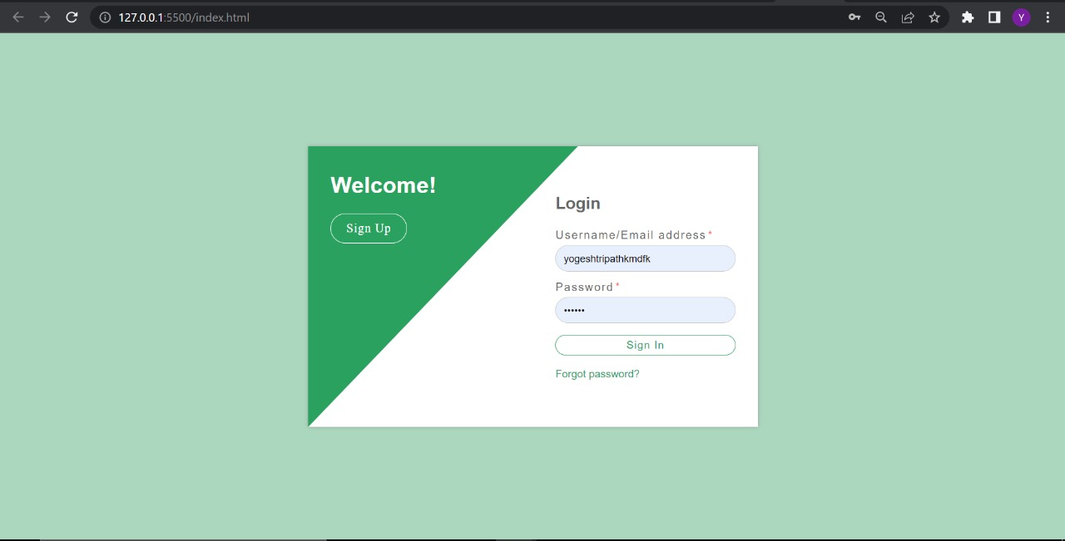
Default page view:-

Slide 7
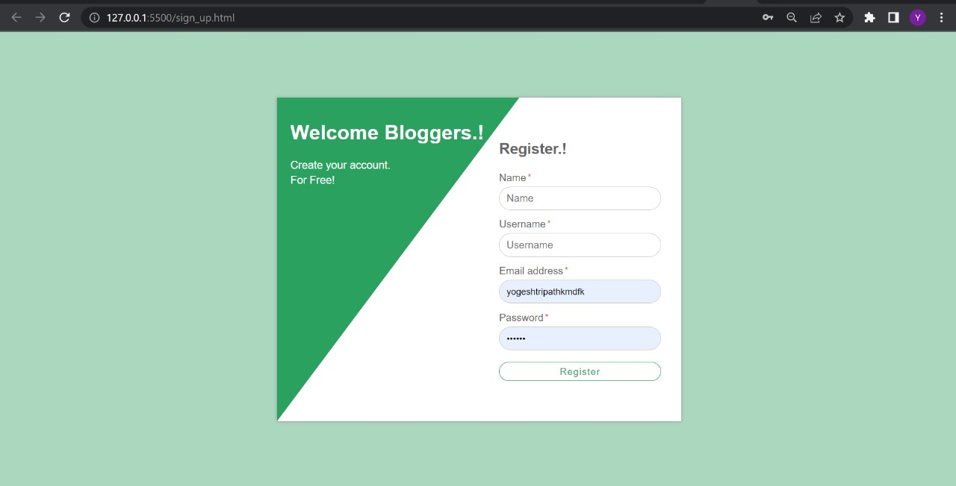
DEFAULT PAGE VIEW:-

Slide 8

DEFAULT PAGE VIEW:-

Slide 9
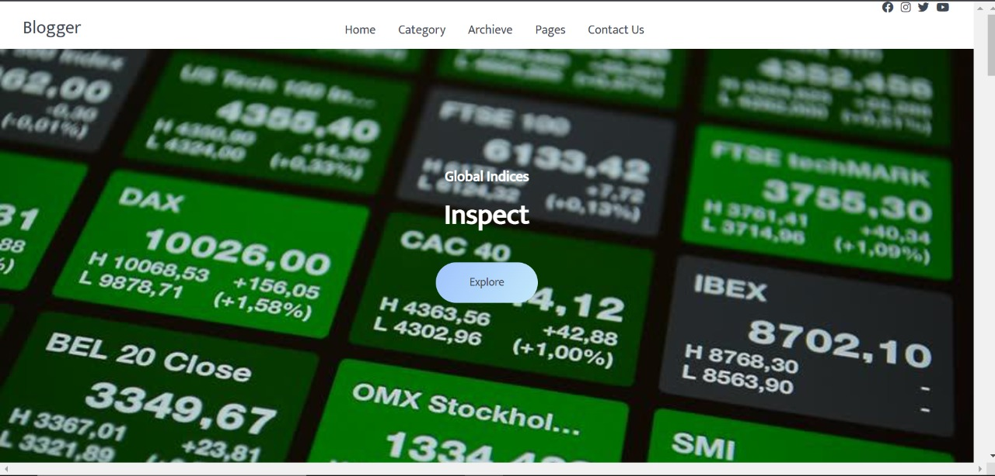
DEFAULT PAGE VIEW:-

Slide 10
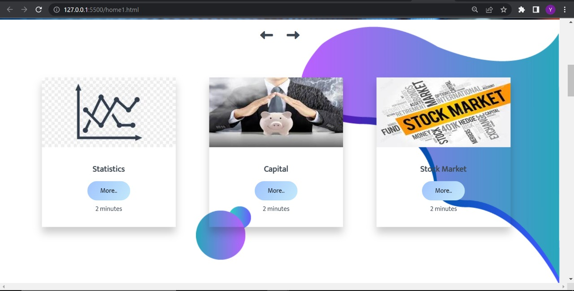
DEFAULT PAGE VIEW:-

Slide 11
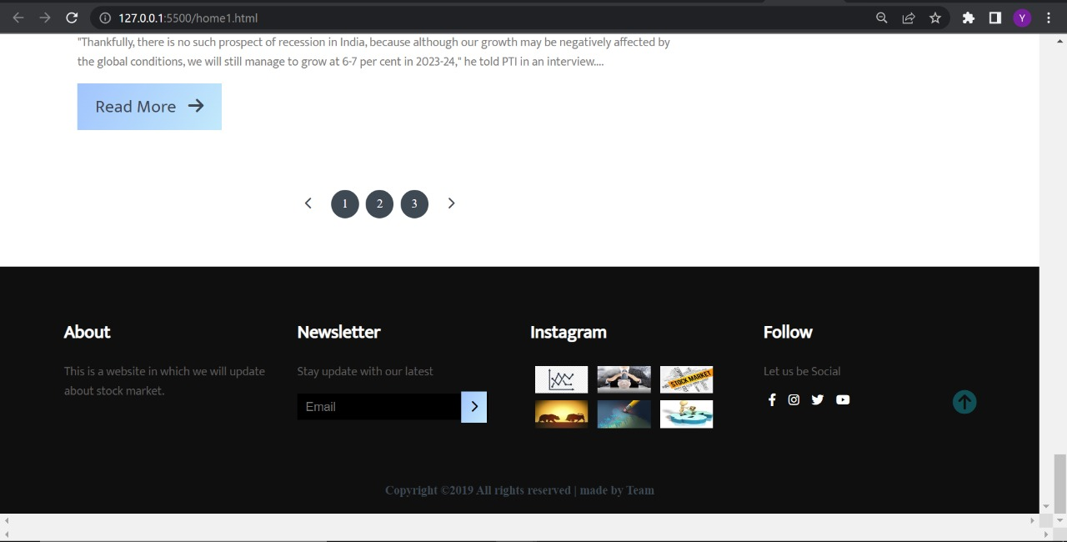
DEFAULT PAGE VIEW:-

Slide 12
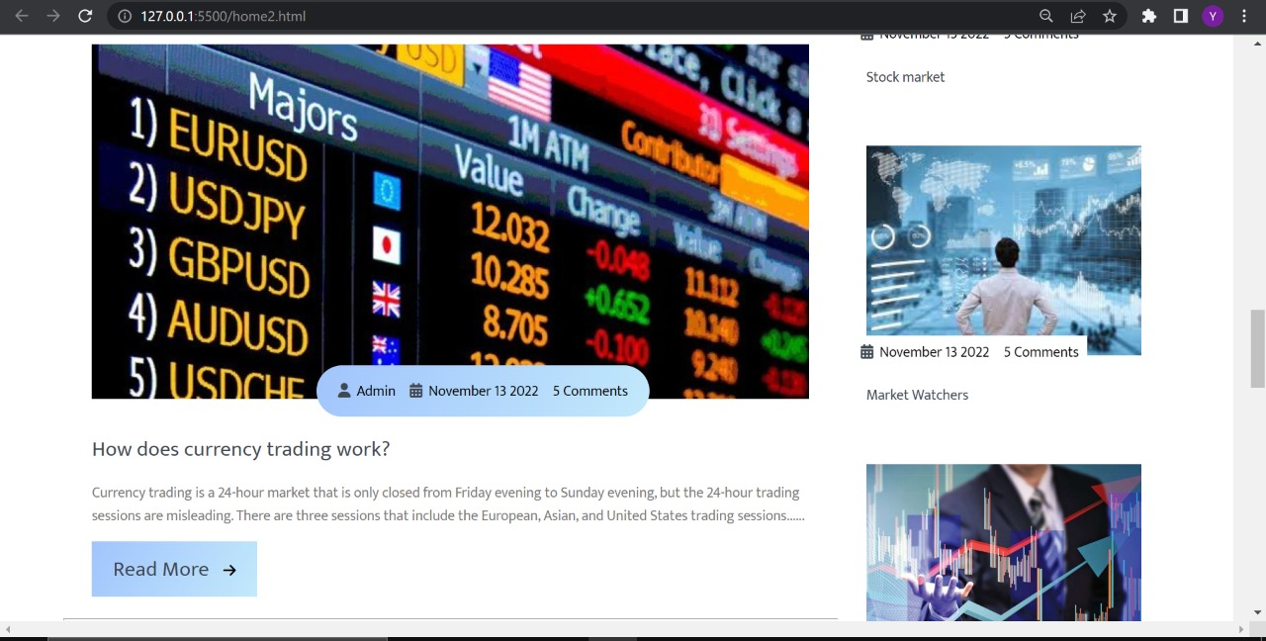
DEFAULT PAGE VIEW:-

Slide 13
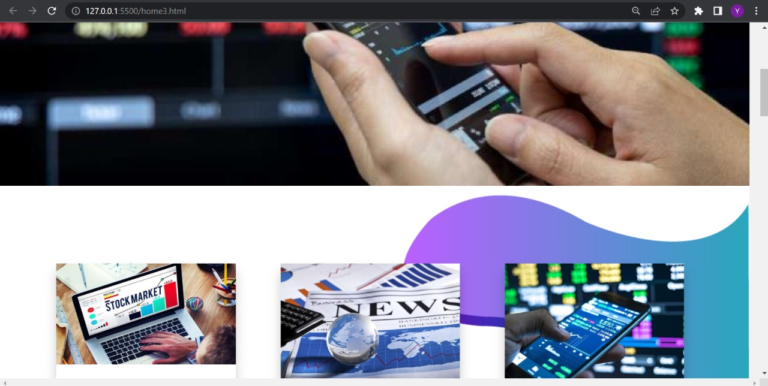
DEFAULT PAGE VIEW:-

Slide 14
Conclusion:-
We have completed our project within time limit with the coordination of our team members under the supervision of our mentor Mr. Bhanu Kapoor.
Our project repository is available at: https://yogesh007587.github.io/project/

Slide 15
THANK YOU

